Slide 1
Brain Stroke Detection Using CNN And SVM

Slide 2
Introduction
Brain stroke occurs when blood circulation to the brain is either reduced or interrupted. When this happens, the brain does not get sufficient oxygen or others necessary ingredients and then the brain cell starts to die. It is also known as brain attack or cerebrovascular accident (CVA).
To perform surgical planning and to initiate the treatment, the Neurosurgeon should be equipped with the precise stage of the affected area.

Slide 3
Motivation
This paper provides an efficient process for proper detection of brain stroke from CT scan images.
A CT scan image of brain is taken as input.
brain stroke could result in the loss of neuromotor and cognitive functions.

Slide 4
Problem statement
The most common types of disability after stroke are impaired speech, restricted physical abilities, weakness or paralysis of limbs on one side of the body, difficulty gripping or holding things, and a slowed ability to communicate.

Slide 5
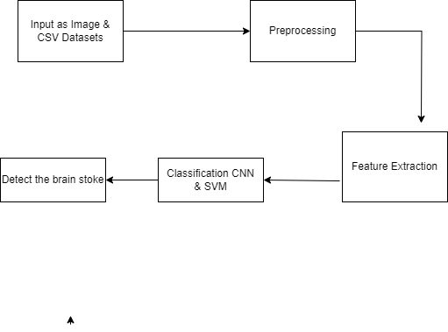
System Architecture

Slide 6
Literature Survey
Sr.No | Paper Name | Author | Abstract
1 | Ischemic Brain Stroke Detection from MRI Image using Logistic Regression Classifier | Md.Shabuj Hossain, Subir Saha, Liton Chandra Paul | — In this paper an efficient model for ischemic brain stroke detection from magnetic resonance imaging (MRI) using machine learning approach namely logistic regression classifier is proposed.

Slide 7
Sr.No | Paper Name | Author | Abstract
2 | Voxel Based Lesion Segmentation Through SVM Classifier for Effective Brain Stroke Detection. | R. Punitha Lakshmi,1 Melingi Sunil Babu2 | The above limitation classification of Ischemic Stroke image is carried out through the Support Vector Machine Classifier with Adaptive Multithresholding Technique.

Slide 8
Sr.No | Paper Name | Author | Abstract
3 | e-ASPECTS for early detection and diagnosis of ischemic stroke | Touati Haifa, Boughariou Jihene | The present paper highlights the recently developed Artificial-Intelligent based tools in diagnosis and treatment of stroke with a comparison with humain score

Slide 9
Sr.No | Paper Name | Author | Abstract
4. | KFCM Algorithm for Effective Brain Stroke Detection through SVM Classifier | Dr.V.Vijayalakshmi | In the existing work, Segmentation of the Ischemic Stroke image was done by Otsu technique and integrated with SVM classifier

Slide 10
Advantages
Like a CT scan, a stroke MRI takes multiple images of the inside of the head using sophisticated x-rays and computers.
Unlike a CT scan, which takes several hours to reveal any blockages of blood flow, an MRI can uncover any brain damage within an hour of the onset of the stroke symptoms.
Timely forecasting is very important to save the life of the patient.
Delay in prediction may lead to fatal outcomes.
The specificity allows the correct identification of patients who can have strokes in the near future

Slide 11
Disadvantages
The most common types of disability after stroke are impaired speech, restricted physical abilities, weakness or paralysis of limbs on one side of the body, difficulty gripping or holding things, and a slowed ability to communicate.

Slide 12
Applications
Computed tomography (CT)-based imaging remains the most common imaging modality to evaluate patients presenting with acute stroke symptoms.
It is easily available, safe, and fast which is critical in acute stroke management.
CT has high sensitivity for the detection of intracerebral hemorrhage.

Slide 13
Conclusion
The real challenge of the classification technique is to attain maximum accuracy compared to manual delineation. By using SVM classifier accuracy and Kappa coefficient of attained. By increasing the number of training dataset and by using kernel operators in the SVM classifier, accurate segmentation of brain and brain lesions is achieved.
. The current density at each source has been estimated. While comparing it with CT-scan/MRI images, it has been seen that a cost-effective and non-invasive device like EEG can be successfully used in order to detect a stroke.

Slide 14
Refrences
[1] Mathers, C.D., Bernard, C., Iburg, K.M., Inoue, M., Ma Fat, D., Shibuya, K., Stein, C., Tomijima, N. and Xu, H., 2004. Global burden of disease: data sources, methods and results. World Health Organization, survey 199998a2.
[2] World Health Organization, 2002. The world health report 2002: reducing risks, promoting healthy life. World Health Organization. [3] Pandian, J.D. and Sudhan, P., 2013. Stroke epidemiology and stroke care services in India. Journal of stroke, 15(3), p.128.
[4] Banerjee, T.K. and Das, S.K., 2016. Fifty years of stroke researches in India. Annals of Indian Academy of Neurology, 19(1), p.1.
[5] Ga, D., 2008. Fisher m, macleod m, Davis Sm. Stroke. Lancet, 371(9624), pp.1612-23.
[6] Radic, B., 2017. Diagnosis and Treatment of Carotid Artery Stenosis. J. Neurol. Stroke, 7(3), pp.9-12.
[7] Ahirwar, D., Shakya, K., Banerjee, A., Khurana, D. and Roy, S., Simulation studies for non invasive classification of Ischemic and Hemorrhagic Stroke using Near Infrared Spectroscopy

